Slide 1
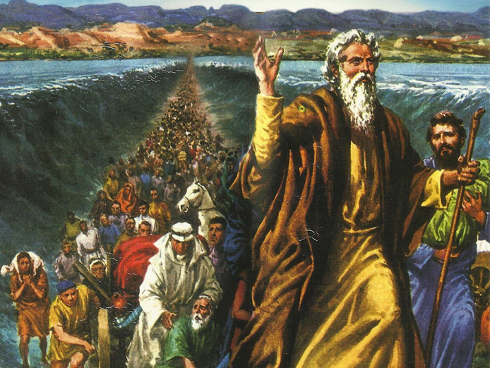
CATECHETICAL TEXTBOOK SERIES OF THE SYRO - MALABAR CHURCH
ON THE PATH OF SALVATION - 5
PEOPLE WHO AWAITED THE REDEEMER
5

Slide 2
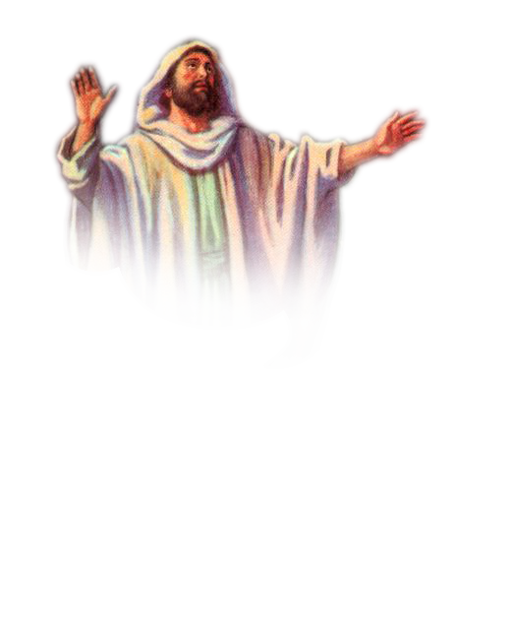
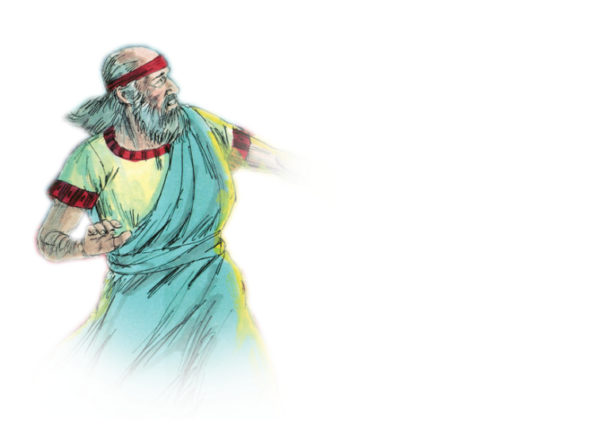
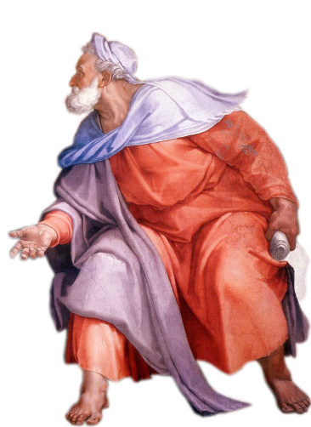
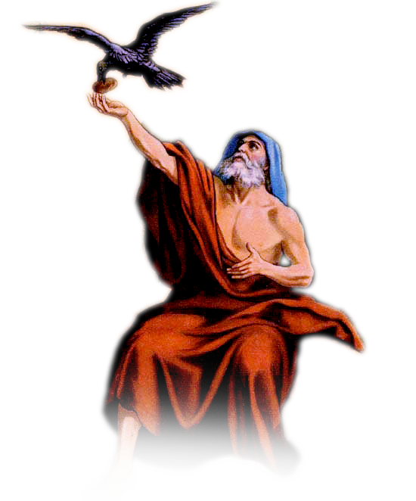
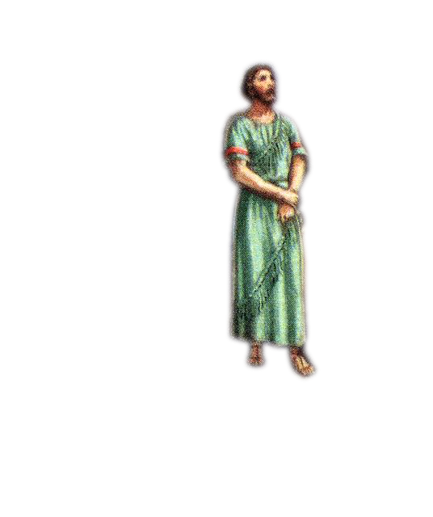
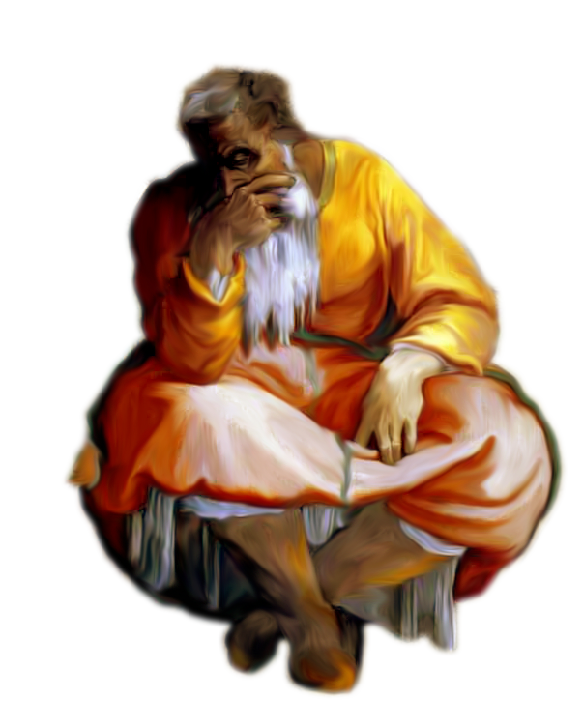
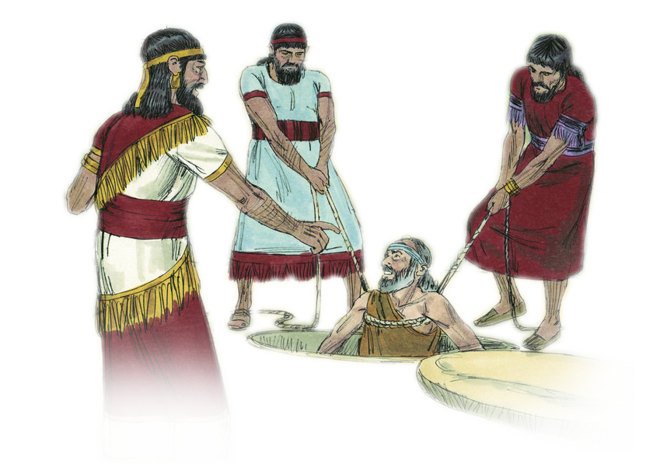
LESSON 14
PROPHETS OF ISRAEL

Slide 3
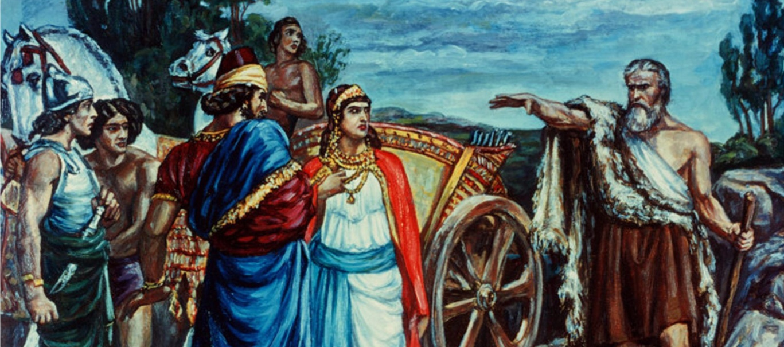
Their lives became steeped in immorality. Prophets were people ordained to bring back to God the Israelites who went on with their lives as if God did not exist.
The common meaning of the word ‘prophet’ is , ‘the one who speaks for God’. The books- Isaiah, Jeremiah, Ezekiel and daniel - are comparatively large ones. These four are known as the great prophets. These are, Hosea, Joel, Amose, Obadiah, Micah, Nahum, Habakkuk, Zephaniah, Haggai, Zechariah, and Malachi.
Israel also had some great prophets in whose names there are no books in the Bible. Chief among them are Elijah and Elisha.

Slide 4
The greater prophets elijah
Prophet Elijah warned the king that he would be punished for idolatry. He advised the king to repent and return to the Lord God.
“The lord indeed is God! The Lord indeed is God”.

Slide 5
isaiah
Isaiah also prophesied about the advent of a savior who would redeem the whole world. Some other visions that we get from his prophecies are the infinite love of God, conversion and the days of hope.

Slide 6
jeremiah
“ Now I have put my words in your mouth. See, today I appoint you over the nations and kingdoms, to pluck up and pull down; to destroy and to overthrow; to build and to plant” (Jeremiah 1:9).

Slide 7
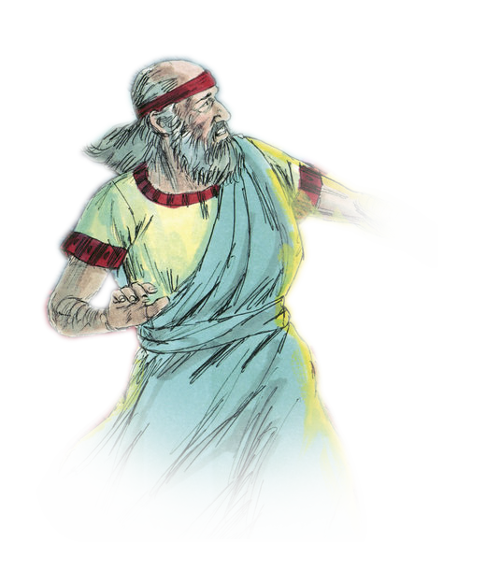
ezekiel
Some of his messages of hope were: Israel will grow as a new nation; a true shepherd shall come to lead them; the spirit of God shall give new life to Israel; a new temple shall be constructed; Glory of God shall be manifested again.

Slide 8
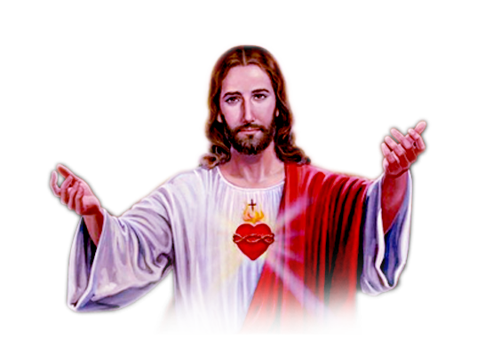
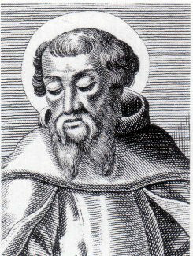
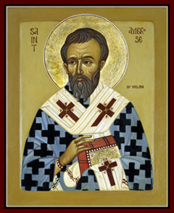
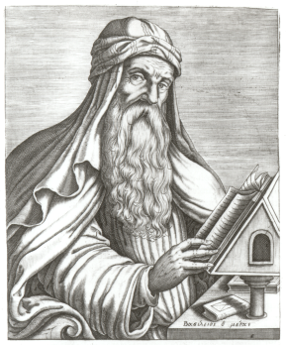
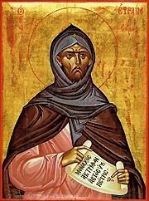
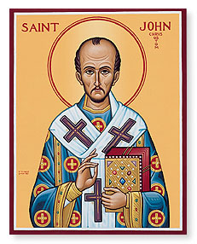
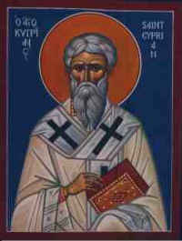
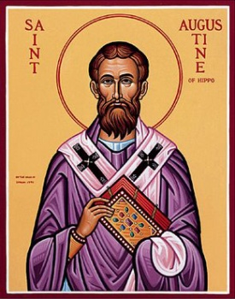
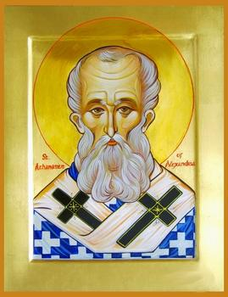
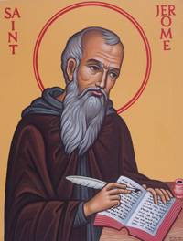
Teachers of the church
In a similar way, the doctors of the church are people who give guidance to the New Testament people, the Church.
Chief among the doctors of the church were the ‘fathers of the church’ who lived in the early centuries. Iraneus, Cyprian, Ambrose, Angustine, Basil, Athanesius, Ephrem, Jerome, John Chrisostom, are prominent among these holy and wise men.

Slide 9
Let us pray
O God, who blessed Israel with prophets and teachers, help us to obey the directives given by the authorities of the Church.

Slide 10
READ AND RECOUNT
Narrate the miracle that prophet Elijah performed to prove that the Lord is God. (1 kings. 18:20-40)

Slide 11

WORD OF GOD FOR GUIDANCE
“ Hate evil and love good, and establish justice in the gate ” (Amos 5:15).

Slide 12
MY DECISION
I will follow the teachings of the Church that helps me to understand the path of God.

Slide 13
LET US DO
Write the names of the prophets who guided the Israelites along the path of God.

Slide 14
LET US FIND OUT THE ANSWER
1. With what purpose were the prophets of Israel appointed?
2. How did each prophet guide the people of Israel along the path of God?
3. What are the messages of hope that prophet Ezekiel gave to Israel?
4. Who are known as the teachers of the Church?
5. Write down the names of five fathers of the Church?

Slide 15
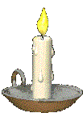


Thank you

